Slide 1
C Programming
Chapter 5
Control Structure

Slide 2
Repitition (loop)
In programming, a loop is used to repeat a block of code until the specified condition is met.
C programming has three types of loops:
for loop
while loop
do...while loop

Slide 3
For loop
The syntax of the for loop is:
for (initializationStatement; testExpression; updateStatement)
{
// statements inside the body of loop
}

Slide 4
How for loop works?
The initialization statement is executed only once.
Then, the test expression is evaluated. If the test expression is evaluated to false, the for loop is terminated.
However, if the test expression is evaluated to true, statements inside the body of for loop are executed, and the update expression is updated.
Again the test expression is evaluated.
This process goes on until the test expression is false. When the test expression is false, the loop terminates.

Slide 5
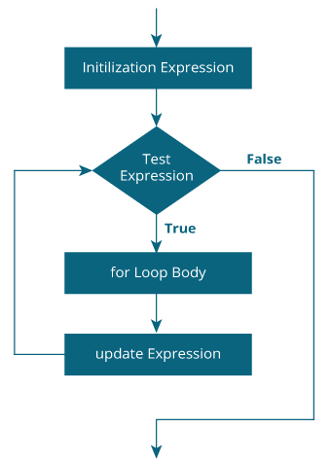
Representing True or False in C

Slide 6
Example for loop
// Print numbers from 1 to 10
#include <stdio.h>
int main() {
int i;
for (i = 1; i < =10; i++)
{
printf("%d ", i);
}
return 0;
}

Slide 7
Example #2 for loop
Program to calculate the sum of first n natural numbers
Positive integers 1,2,3...n are known as natural numbers

Slide 8
Example #2 for loop
#include <stdio.h>
int main()
{
int num, count, sum = 0;
printf("Enter a positive integer: ");
scanf("%d", &num);
// for loop terminates when num is less than count
for(count = 1; count <= num; ++count)
{
sum += count;
}
printf("Sum = %d", sum);
return 0;
}

